Slide 1
Raster Aggregation, Disaggregation, and Resampling
Cadence, Andrew, Tanjina, Aciano

Slide 2
Learning Objectives:
You will be able to:
Describe what each method does to raster data
Identify when to use each method
Implement each method using raster data in R

Slide 3
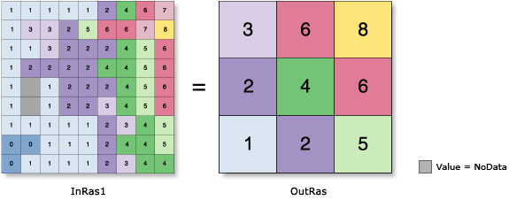
Aggregation
Combines raster cells into larger cells to produce a raster with a lower resolution
Importances:
Reducing size of data - lower size increases computation speed
Visual interpretation - smooths data to see larger changes
Ex: Local climate compared to regional climate
Compatibility - downscaling from a high resolution to match a lower resolution

Slide 4
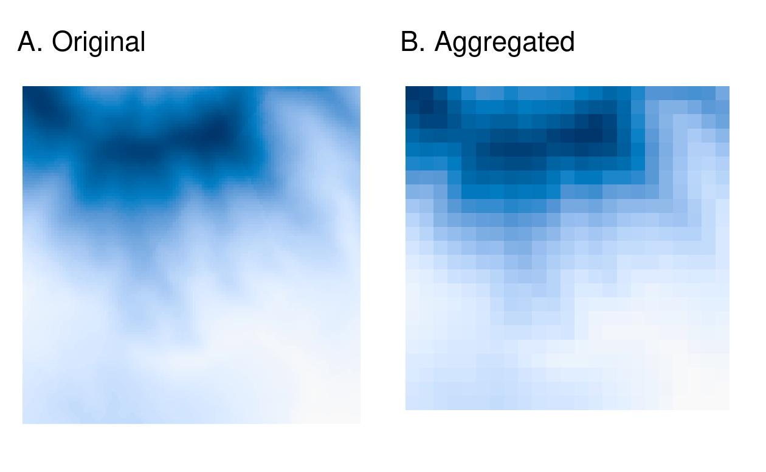
Aggregation Example:
Original Raster
Loading in a raster (tif) file

Slide 5
Aggregation Example:
Function in terra package
Original Raster
Method of aggregation
# of columns + rows in each direction

Slide 6
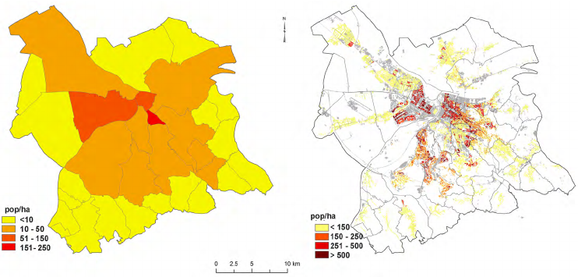
Disaggregation
Disagg() -> increases the resolution of raster objects
Why Disaggregation?
“The corresponding values, however, are only as accurate as their lower resolution source.” (Lovelace)
Dasymetric Map
Choropleth Map
Notes:
"Choropleth Map (Left) and Dasymetric Map (Right) Depicting Population Density for the Year [Year]." ResearchGate, www.researchgate.net/figure/Choroplet-map-left-and-dasymetric-map-right-depicting-population-density-for-the-year_fig3_259479214. Accessed 4 Mar. 2025.

Slide 7

Example of Disaggregated R Code
disagg(x, fact, method="near", filename="", ...)
METHOD = Optional argument,
Interpolation method to define new cells
Raster
Fact = # of columns and rows (MUST BE POSITIVE)

Slide 8
Resampling
Aggregating & Disaggregating are only suitable for changing the resolution of the raster
Resampling is:
a process of computing values for new pixel locations.
good for when we have multiple data sets with different resolutions /origins
Uses:
Aligning multiple rasters with different resolutions or coordinate systems.
Standardizing raster datasets

Slide 9

Resampling
Start with a target raster: What we want to resample to
Target raster
Raster you’re changing
Method to estimate the new values

Slide 10
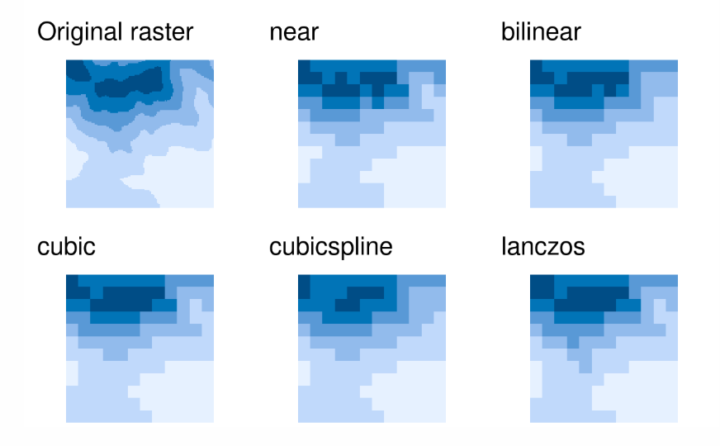
Types of Resampling
Optimal Scenarios
Near - Categorical Raster
Bilinear- Fastest for continuous rasters
Cubic- Used for continuous rasters, uses values from 16 nearest cells
Cubic Spline- same as cubic applies splines
Lanczos- Used for continuous rasters, uses values from 36 nearest cells

Slide 11
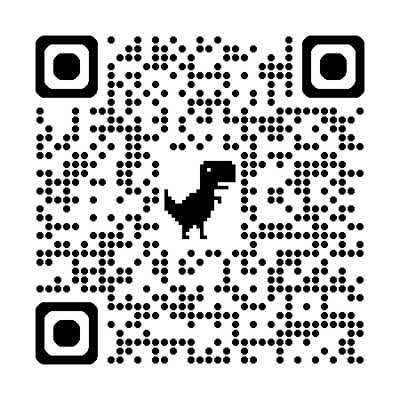
Quiz Time !!!! 𓆝

